Slide 1

[GIST - AI Lab]창의 융합 경진 대회
Vision for Robotics
- 이상범 -
광주과학기술원
인공지능 연구실
1

Slide 2
Overview
Goal
ROS 개발 환경에서 real-time object tracker 구현
Python으로 real-time object tracker 구현 실습
Contents
Color detection using HSV color map, OpenCV in ROS environment
Object detection using pre-trained model in ROS environment
Real-time Object tracking using OpenCV
2

Slide 3
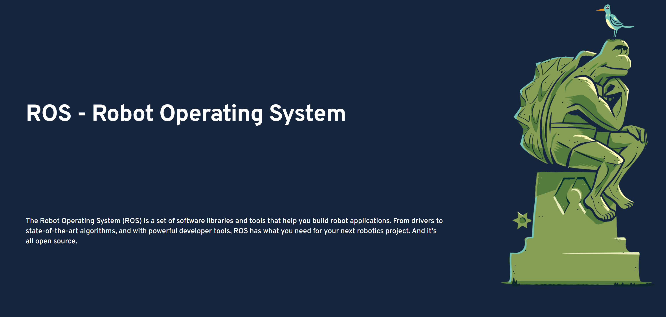
ROS Review
ROS란
ROS는 로봇 시스템을 구성하고 활용하기 위해 사용하는 시스템
추후 시스템 구성 시 ROS 혹은 LabView 중 선택
https://www.ros.org/
3

Slide 4
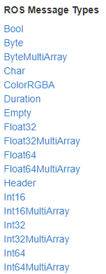
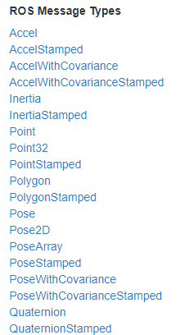
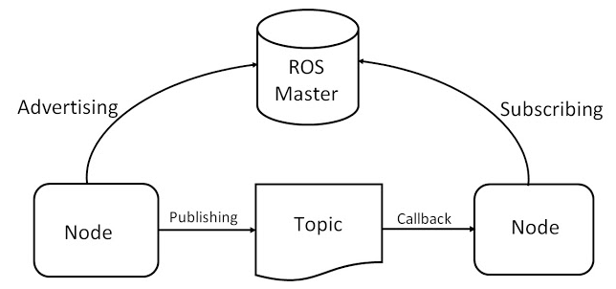
ROS Review
ROS Topic
Ros에서 노드들 간 통신을 할 수 있는 채널
복수의 노드들끼리 통신하면서 메시지를 주고 받을 수 있으며, 이 경로를 topic 이라 부름
ROS message
Topic이 데이터를 주고 받을 때 사용하는 포맷
Message type : bool, int, float, double
Rospy message : std_msgs, geometry_msgs
<std_msgs>
<geometry_msgs>
3

Slide 5
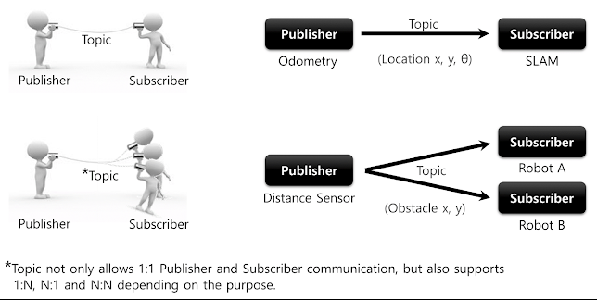
ROS Review
Publisher
Topic을 통해 message를 발생하는 node
복수의 publisher가 같은 topic을 발생할 수 있음
Subscriber
Topic으로 message를 받는 node
복수의 subscriber가 같은 topic을 받을 수 있음
Rospy
ROS topic 통신이 가능한 파이썬 라이브러리
4

Slide 6
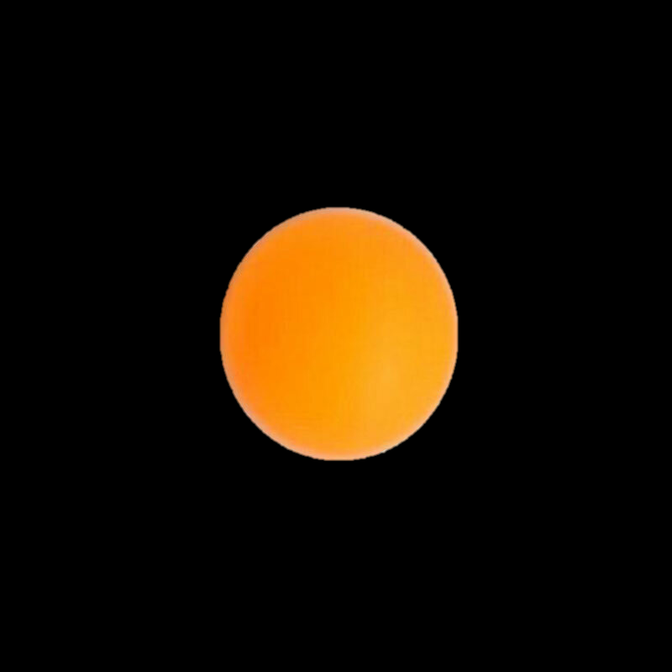
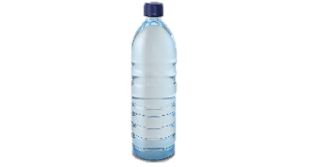
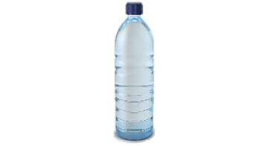
ROS Review
ROS based Robotic system pipeline
Goal
모바일 로봇 제어부 ROS
물체 위치
로봇팔 제어부 ROS
물체 위치
물체 인식부
Deep Learning
센서부
실시간 이미지
Color Detection
Object Detection
Object Tracking
5

Slide 7
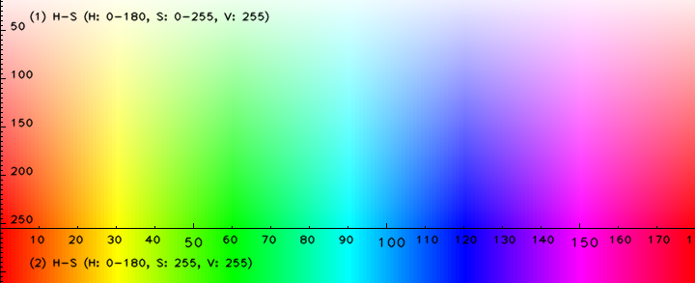
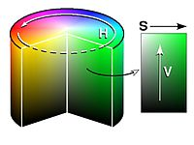
Object Tracker
Color detection using HSV color map, OpenCV in ROS environment
HSV ?
색을 표현하는 하나의 방법
색상 (Hue), 채도 (Saturation), 명도 (Value)의 좌표를 사용하여 특정한 색을 지정
6

Slide 8
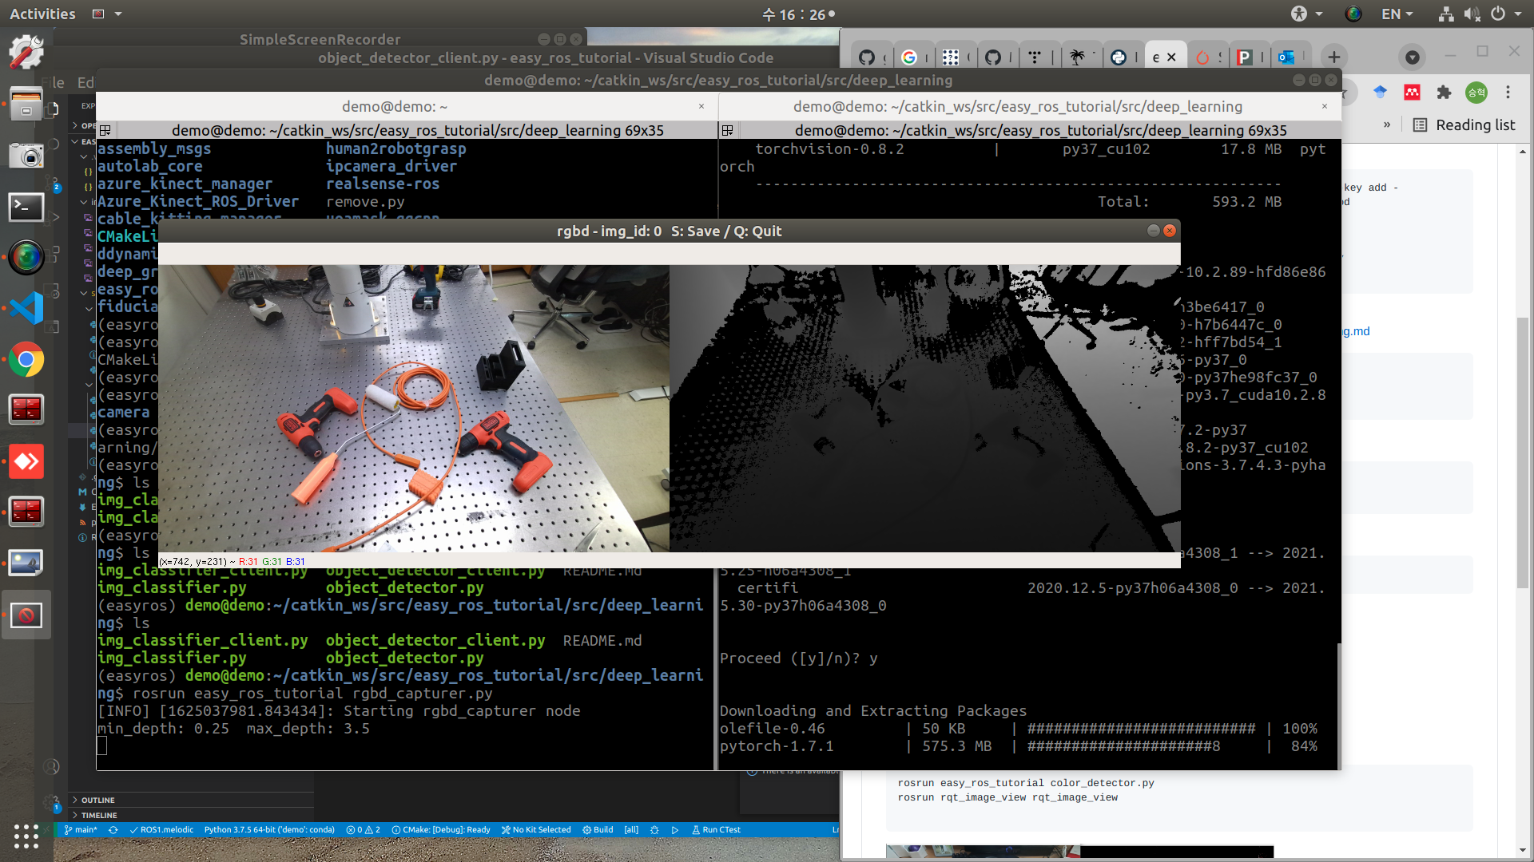
Object Tracker
Color detection using HSV color map, OpenCV in ROS environment
Goal
아래의 Scene에서 ‘Orange Color detection’
7

Slide 9
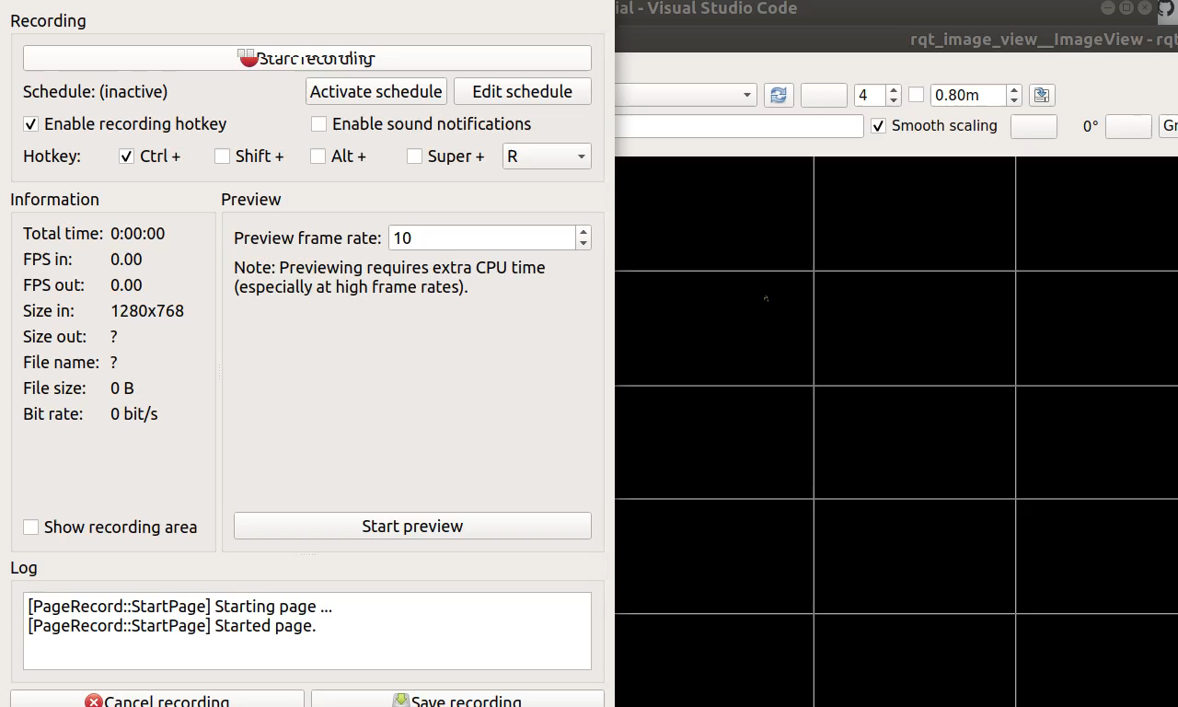
Object Tracker
Color detection using HSV color map, OpenCV in ROS environment
8

Slide 10
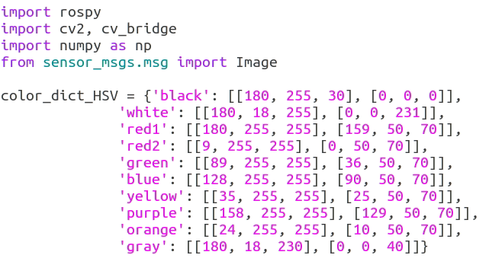
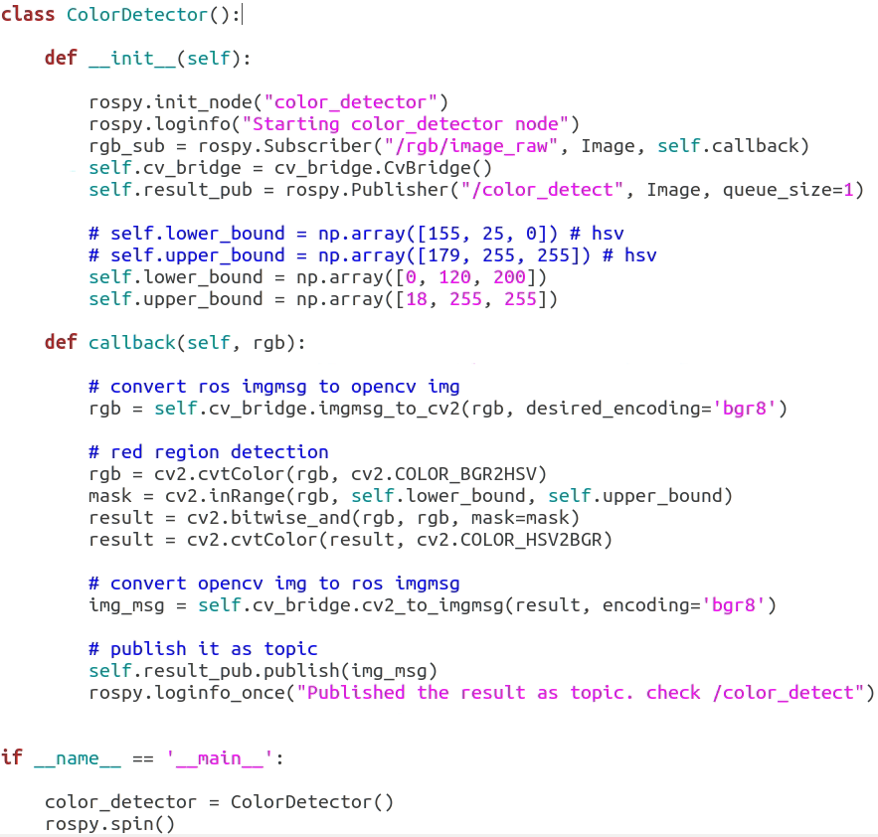
Object Tracker
Color detection using HSV color map, OpenCV in ROS environment
Color Dictionary
From Camera
Orange Color HSV
Extract Orange Mask
9

Slide 11
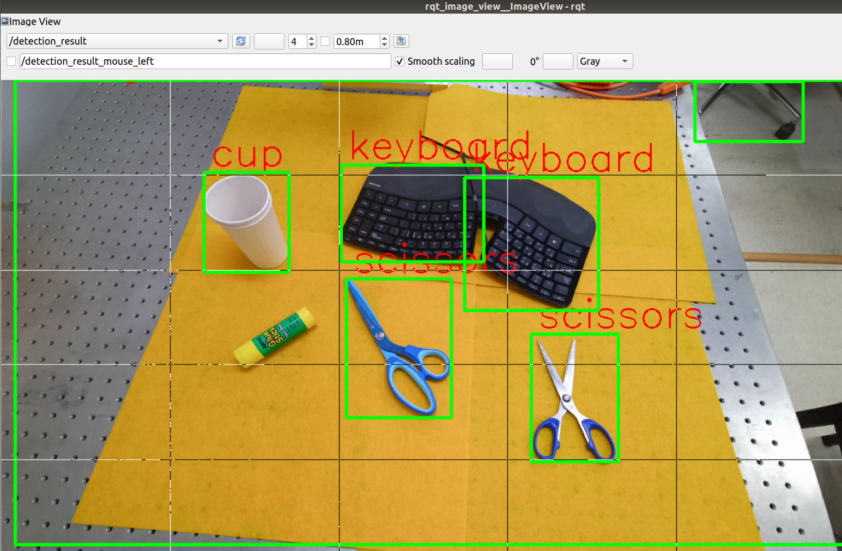
Object Tracker
Object detection using pre-trained model in ROS environment
10

Slide 12
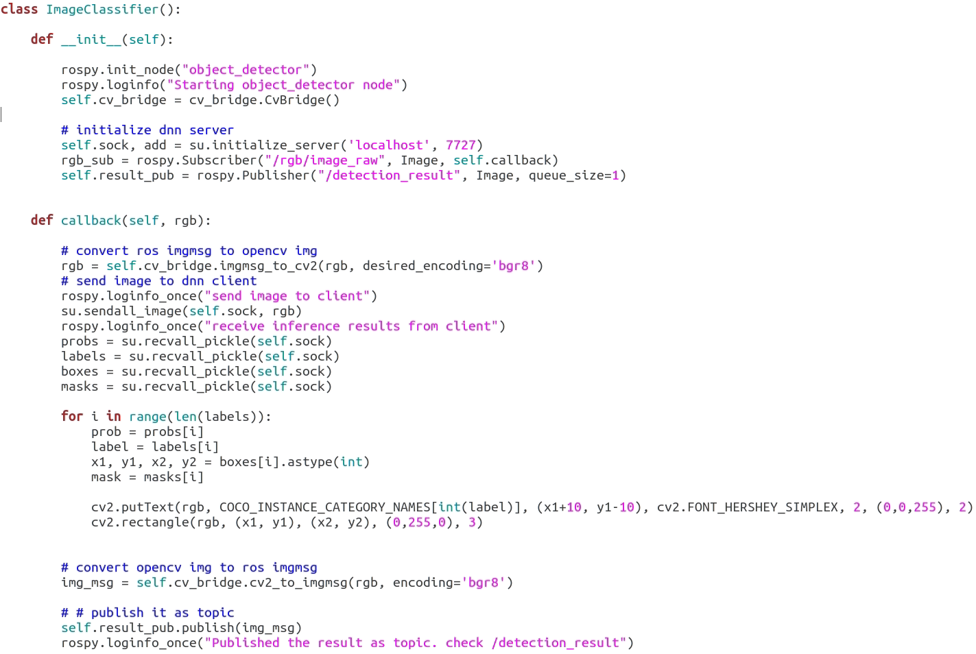
Object Tracker
Object detection using pre-trained model in ROS environment, Python 2
실시간으로 이미지 받아오기
Object Detection 모델 서버에 이미지 전송
Object Detection 모델 서버에서 결과를 받아서 visualization
11

Slide 13
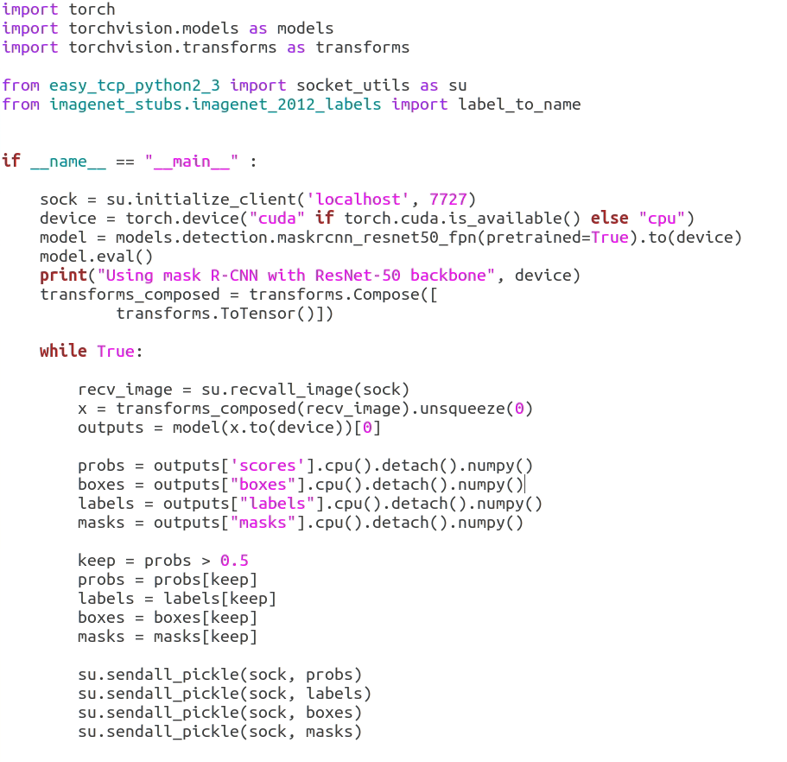
Object Tracker
Object detection using pre-trained model in ROS environment, Python3
MaskRCNN 모델 선언
이미지 전송 노드에서 이미지 받아오기
MaskRCNN을 사용한 물체 탐색 후 결과 전송 (Object Detection)
12

Slide 14
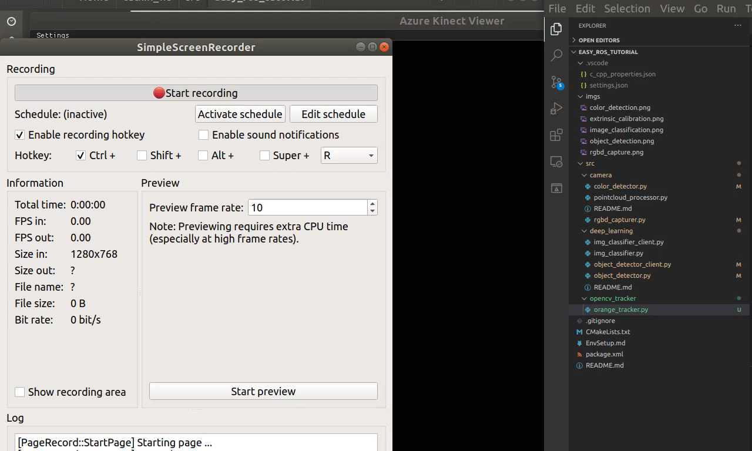
Object Tracker
Real-time Object tracking using OpenCV
13

Slide 15
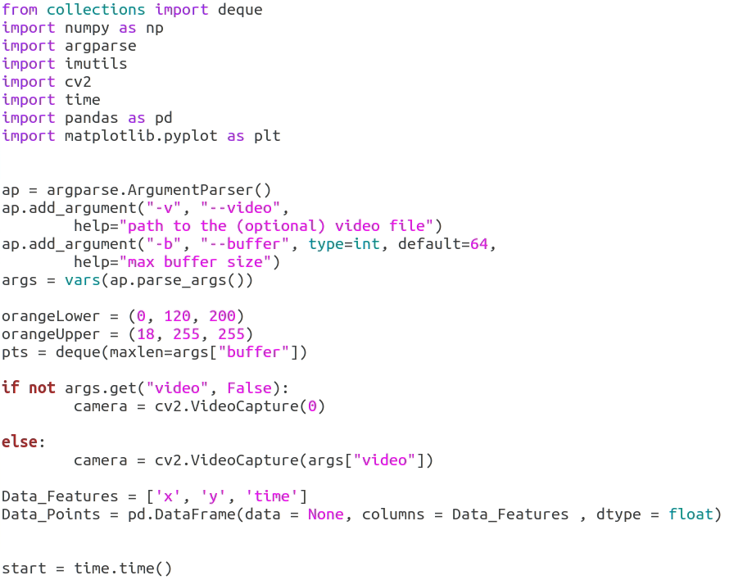
Object Tracker
Real-time Object tracking using OpenCV
HSV 컬러 범위 설정
14

Slide 16
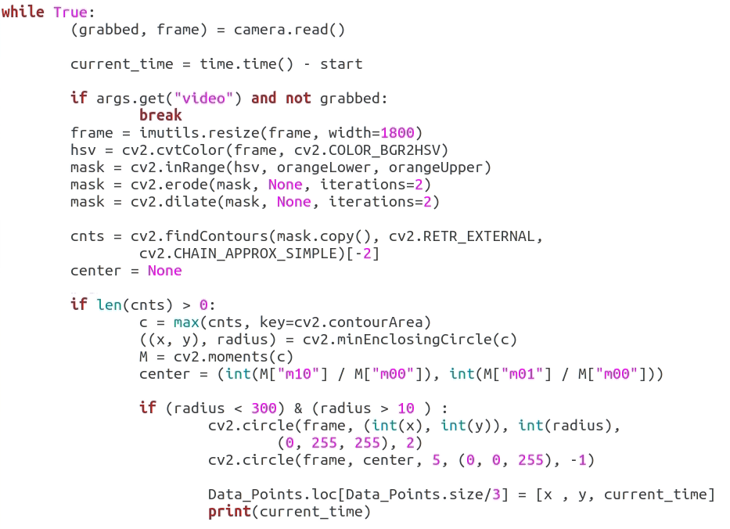
Object Tracker
Real-time Object tracking using OpenCV
물체 tracking
Tracking 할 물체 범위 설정
15

Slide 17
Issue
고려해야할 사항들
Goal
카메라 latency
하드웨어 특성에 따라 다르기 때문에 실제 latency 문제를 개선하기 어려움
USB 카메라 사용시, fps
Resolution이 낮을 수록 fps는 빨라짐
16

Slide 18
Environment Setup
Install ROS (Ubuntu 18.04, ROS melodic)
$ sudo sh -c 'echo "deb http://packages.ros.org/ros/ubuntu $(lsb_release -sc) main" > /etc/apt/sources.list.d/ros-latest.list'
$ sudo apt-key adv --keyserver 'hkp://keyserver.ubuntu.com:80' --recv-key C1CF6E31E6BADE8868B172B4F42ED6FBAB17C654
$ sudo apt update
$ sudo apt install ros-melodic-desktop-full
$ echo "source /opt/ros/melodic/setup.bash" >> ~/.bashrc
$ echo "export ROS_MASTER_URI=http://localhost:11311" >> ~/.bashrc
$ echo "export ROS_HOSTNAME=localhost" >> ~/.bashrc
$ echo "export ROS_IP=localhost" >> ~/.bashrc
$ source ~/.bashrc
$ sudo apt install python-rosdep python-rosinstall python-rosinstall-generator python-wstool build-essential
17

Slide 19
Environment Setup
Create catkin workspace for ROS
$ mkdir -p ~/catkin_ws/src
$ cd ~/catkin_ws/src
$ catkin_init_workspace
$ echo "source ~/catkin_ws/devel/setup.bash" >> ~/.bashrc
$ cd ~/catkin_ws/
$ catkin_make
Create anaconda environment for using ROS (python 2.7) – python 3.xx 버전도 같은 방법
$ conda create -n easyros python=2.7
$ conda activate easyros
$ conda install -c conda-forge rospkg catkin_pkg
$ conda install pip
$ pip install -U rosinstall_generator wstool rosinstall six vcstools msgpack empy
18

Slide 20
Environment Setup
Install Azure Kinect SDK (link : https://github.com/microsoft/Azure-Kinect-Sensor-SDK/blob/develop/docs/usage.md#Installation)
$ curl -sSL https://packages.microsoft.com/keys/microsoft.asc | sudo apt-key add -
$ sudo apt-add-repository https://packages.microsoft.com/ubuntu/18.04/prod
$ sudo apt update
$ sudo apt install libk4a1.4 libk4a1.4-dev k4a-tools
$ git clone https://github.com/microsoft/Azure-Kinect-Sensor-SDK
$ sudo cp Azure-Kinect-Sensor-SDK/scripts/99-k4a.rules /etc/udev/rules.d/
$ k4aviewer # usb 3 is required
19

Slide 21
Environment Setup
Install Azure Kinect ROS driver (https://github.com/microsoft/Azure_Kinect_ROS_Driver/blob/melodic/docs/building.md)
$ cd ~/catkin_ws/src
$ git clone https://github.com/microsoft/Azure_Kinect_ROS_Driver
$ cd ~/catkin_ws && catkin_make
20

Slide 22
Play with Azure Kinect
Build ROS package
$ cd catkin_ws/src
$ git clone https://github.com/gist-ailab/pingpong-robot-lecture
$ cd ~/catkin_ws/
$ catkin_make
RGB-D capture
$ rosrun pingpong-robot-lecture rgbd_capturer.py
Color detection
rosrun pingpong-robot-lecture color_detector.py
rosrun rqt_image_view rqt_image_view #visualize
Github 주소:https://github.com/gist-ailab/pingpong-robot-lecture
21

Slide 23
Play with Azure Kinect
Object Detector
# python 2
$ conda create -n easyros python=2.7
$ conda activate easyros
$ easy-tcp-python2-3 pickle-compat
# python 3
$ conda create -n easyros-py37 python=3.7
$ conda activate easyros-py37
$ pip install torch torchvision easy-tcp-python2-3 pickle-compat opencv-python six
$ pip install git+https://github.com/nottombrown/imagenet_stubs
22

Slide 24
Play with Azure Kinect
Object Detector
Launch k4a driver
$ roslaunch azure_kinect_ros_driver driver.launch \
color_resolution:=720P depth_mode:=NFOV_2X2BINNED fps:=5
Run DNN server node (ROS, python 2.7)
$ conda activate “env_name”
$ rosrun pingpong-robot-lecture object_detector.py
Run DNN client node (ROS, python 3.7)
$ conda activate “env_name”
$ roscd pingpong-robot-lecture && python src/deep_learning/object_detector_client.py
23

Slide 25
Play with Azure Kinect
Object Tracker
$ cd ~/catkin_ws/src/pingpong-robot-lecture/src/opencv_tracker
$ python orange_tracker.py
24

Slide 26
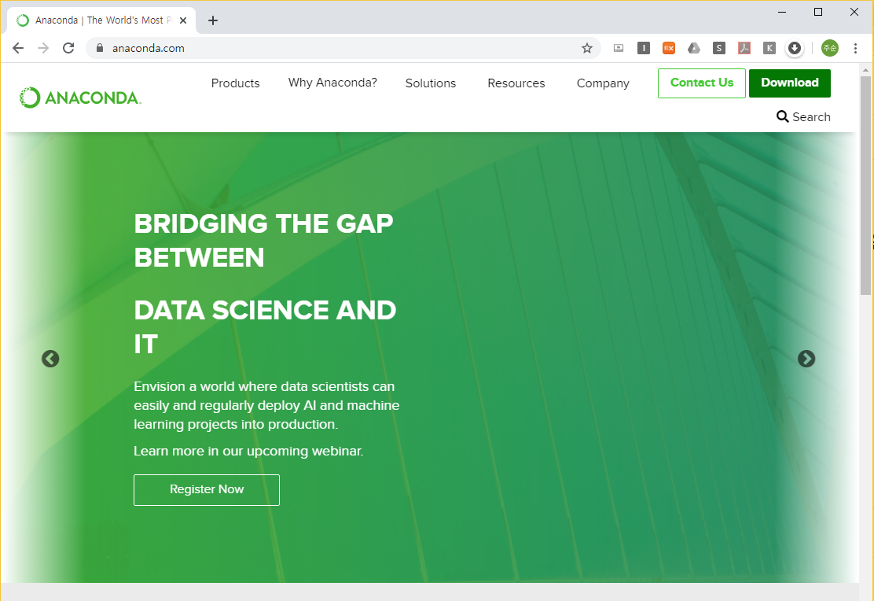
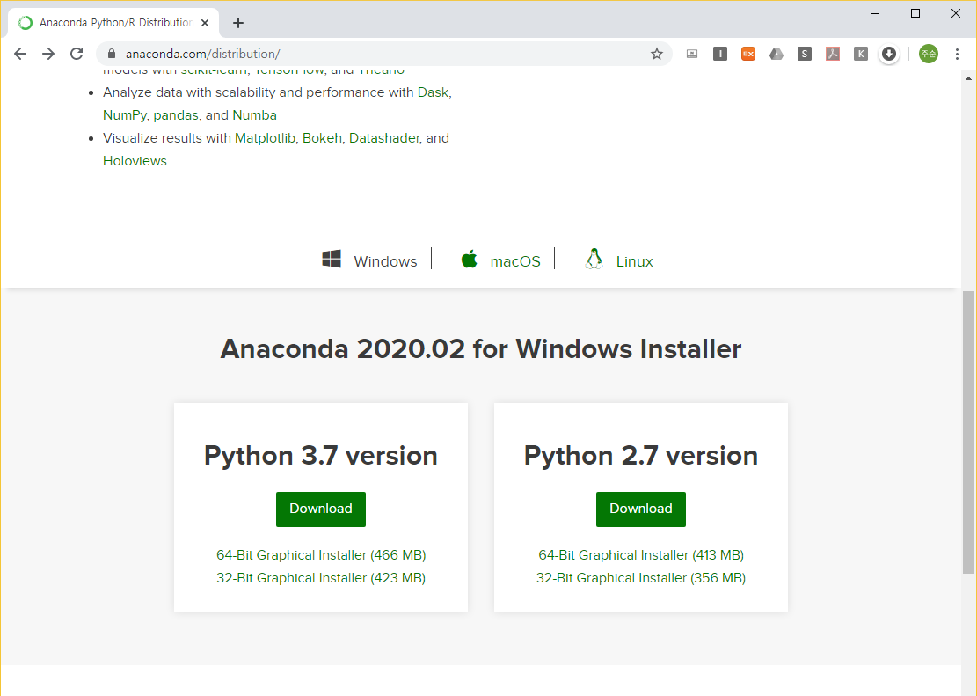
Anaconda Installation
Anaconda Installation for Python ( Link : https://www.anaconda.com/ )
Why using conda ?
여러 패키지를 묶어 놓은 파이썬 배포판
Numpy, Matplotlib 등 다양한 패키지 포함
원하는 파이썬 버전을 선택하여 개발 환경 구축 가능
OS
CLICK
Python version

Slide 27
Play with Azure Kinect
Create Environment
가상 환경
아나콘다에서 제공하는 가상 개발 환경
필요한 패키지와 python version 충돌을 방지 하기 위해 가상 환경을 생성하여 개발
가상 환경 생성
$ conda create –n “env-name” python=2.7 (python 2 for ROS)
$ conda create –n “env-name” python=3.xx (python3 for deep learning)

Slide 28
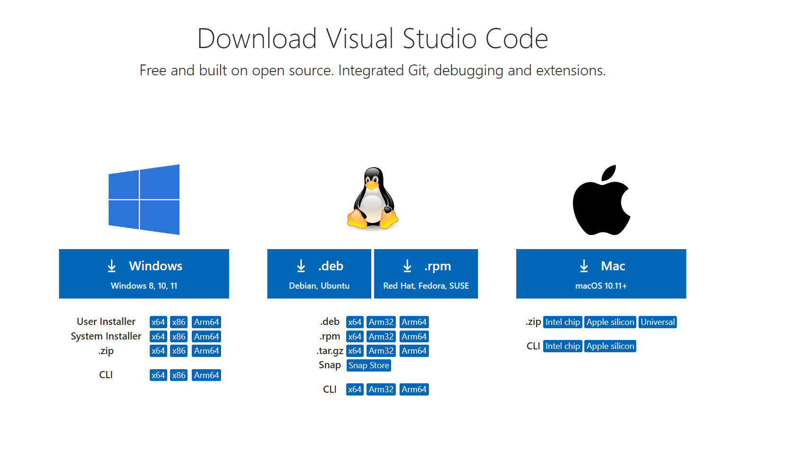
VSCode Installation
VSCode Installation for Python ( Link : https://code.visualstudio.com/download)
IDE (Optional)
Ubuntu
Windows

Slide 29
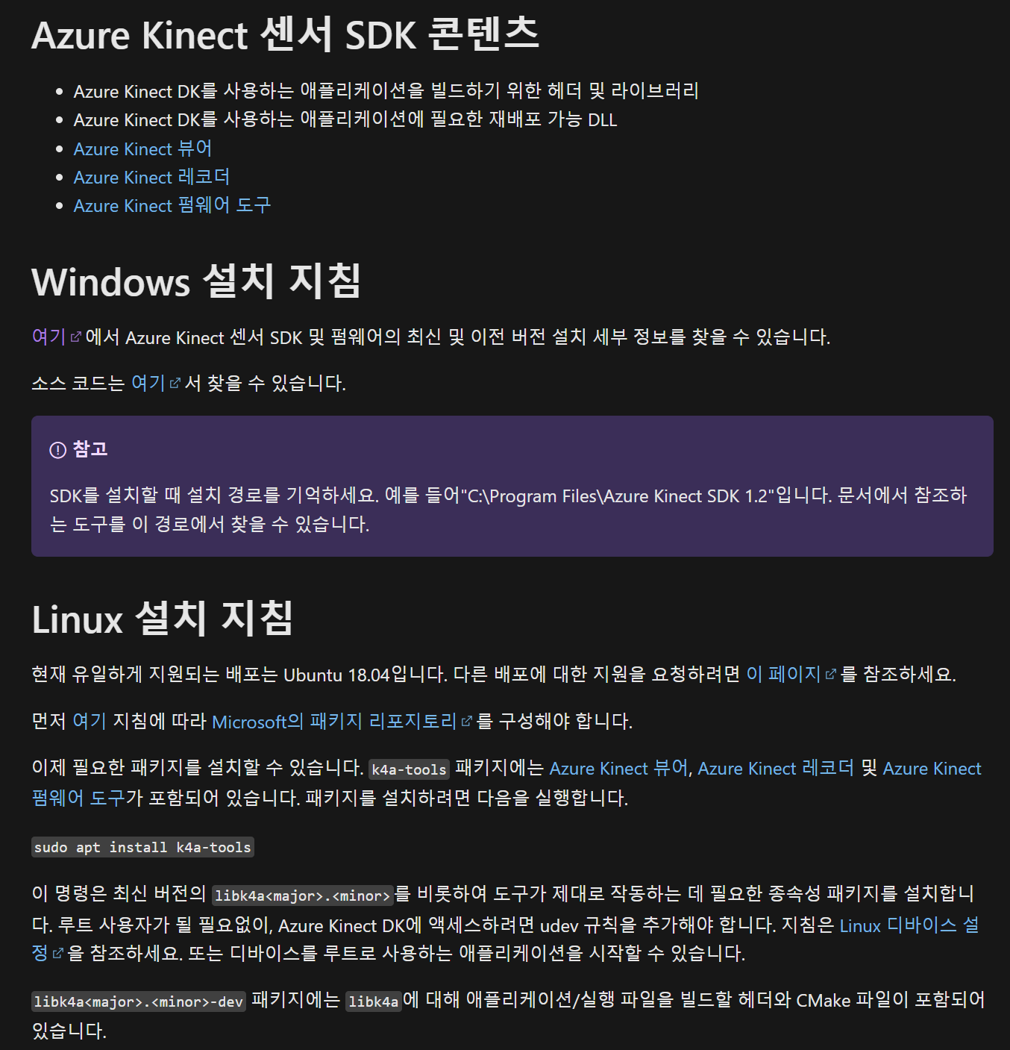
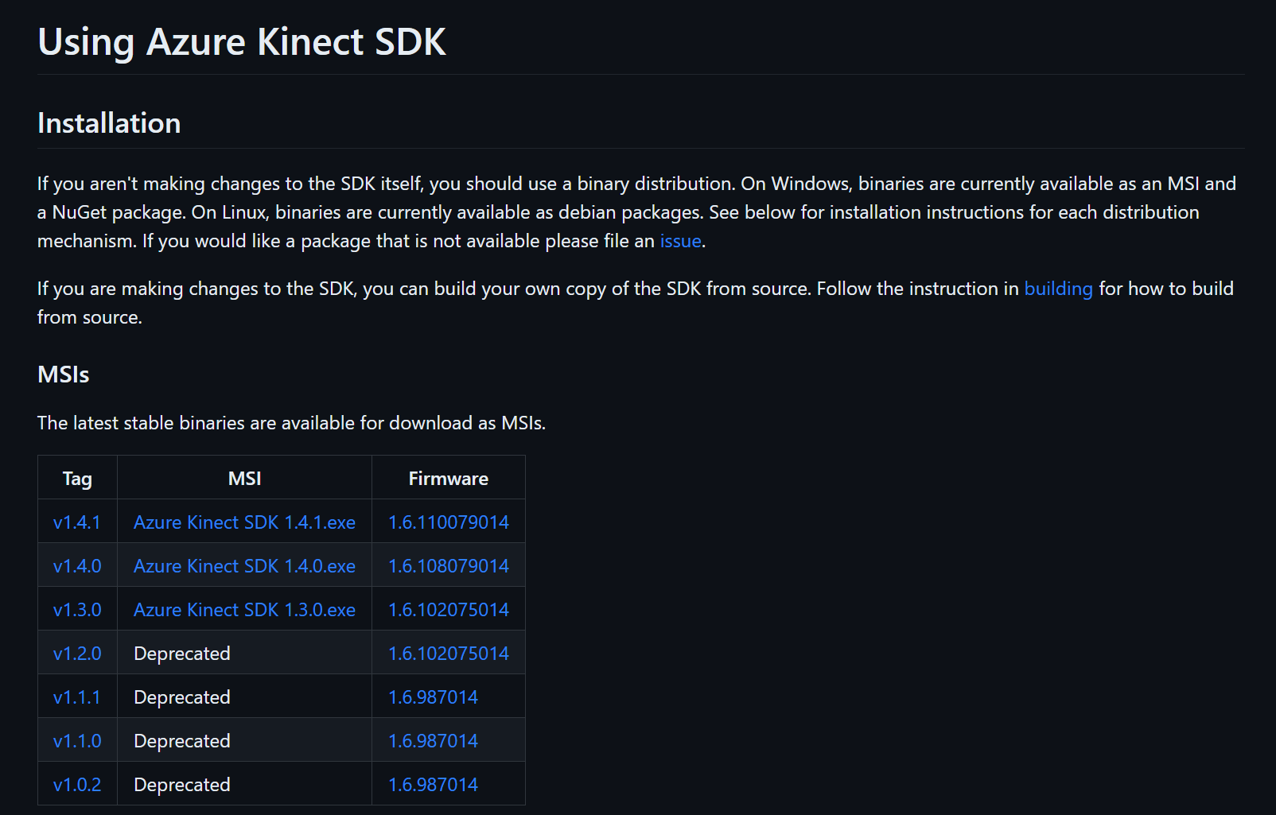
Azure Kinect SDK
Azure Kinect SDK
https://learn.microsoft.com/ko-kr/azure/kinect-dk/sensor-sdk-download
Windows
24

Slide 30
Azure Kinect SDK
Azure Kinect SDK
https://learn.microsoft.com/ko-kr/azure/kinect-dk/sensor-sdk-download
Azure Kinect SDK for Ubuntu
$ curl -sSL https://packages.microsoft.com/keys/microsoft.asc | sudo apt-key add -
$ sudo apt-add-repository https://packages.microsoft.com/ubuntu/18.04/prod
$ sudo apt update
$ sudo apt install libk4a1.4 libk4a1.4-dev k4a-tools
$ git clone https://github.com/microsoft/Azure-Kinect-Sensor-SDK
$ sudo cp Azure-Kinect-Sensor-SDK/scripts/99-k4a.rules /etc/udev/rules.d/
$ k4aviewer # usb 3 is required
Ubuntu
24

Slide 31
Environment Setup
Install Azure Kinect SDK (link : https://github.com/microsoft/Azure-Kinect-Sensor-SDK/blob/develop/docs/usage.md#Installation)
$ curl -sSL https://packages.microsoft.com/keys/microsoft.asc | sudo apt-key add -
$ sudo apt-add-repository https://packages.microsoft.com/ubuntu/18.04/prod
$ sudo apt update
$ sudo apt install libk4a1.4 libk4a1.4-dev k4a-tools
$ git clone https://github.com/microsoft/Azure-Kinect-Sensor-SDK
$ sudo cp Azure-Kinect-Sensor-SDK/scripts/99-k4a.rules /etc/udev/rules.d/
$ k4aviewer # usb 3 is required
19

Slide 32
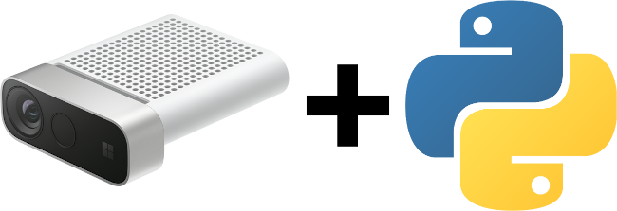
Azure Kinect Python
Azure Kinect Python Package
https://github.com/etiennedub/pyk4a
This library is a simple and pythonic wrapper in Python 3 for the Azure-Kinect-Sensor-SDK.
pip install pyk4a
24

Slide 33
Azure Kinect Python
from collections import dequeimport numpy as np
import imutils
import cv2
import pyk4a
from pyk4a import Config, PyK4A
k4a = PyK4A(
Config(
color_resolution=pyk4a.ColorResolution.RES_720P,
depth_mode=pyk4a.DepthMode.NFOV_UNBINNED,
synchronized_images_only=True,
)
)
k4a.start()
# getters and setters directly get and set on device
k4a.whitebalance = 4500
assert k4a.whitebalance == 4500
k4a.whitebalance = 4510
assert k4a.whitebalance == 4510
i = 0
while 1:
capture = k4a.get_capture()
if np.any(capture.color):
im = capture.color[:, :, :3]
cv2.imshow('Color', im)
key = cv2.waitKey(1)
if key != -1:
cv2.destroyAllWindows()
break
k4a.stop()
Azure Kinect Python Inference
https://github.com/etiennedub/pyk4a
This library is a simple and pythonic wrapper in Python 3 for the Azure-Kinect-Sensor-SDK.
PyK4A
Inference Part
24

Slide 34
i = 0
while 1:
capture = k4a.get_capture()
if np.any(capture.color):
im = capture.color[:, :, :3]
frame = imutils.resize(im, width=1800)
hsv = cv2.cvtColor(frame, cv2.COLOR_BGR2HSV)
mask = cv2.inRange(hsv, orangeLower, orangeUpper)
mask = cv2.erode(mask, None, iterations=2)
mask = cv2.dilate(mask, None, iterations=2)
cnts = cv2.findContours(mask.copy(), cv2.RETR_EXTERNAL,
cv2.CHAIN_APPROX_SIMPLE)[-2]
center = None
if len(cnts) > 0:
c = max(cnts, key=cv2.contourArea)
((x, y), radius) = cv2.minEnclosingCircle(c)
M = cv2.moments(c)
center = (int(M["m10"] / M["m00"]), int(M["m01"] / M["m00"]))
if (radius < 300) & (radius > 10 ) :
cv2.circle(frame, (int(x), int(y)), int(radius),
(0, 255, 255), 2)
cv2.circle(frame, center, 5, (0, 0, 255), -1)
# Data_Points.loc[Data_Points.size/3] = [x , y, current_time]
# print(current_time)
# update the points queue
pts.appendleft(center)
# loop over the set of tracked points
for i in range(1, len(pts)):
# if either of the tracked points are None, ignore
# them
if pts[i - 1] is None or pts[i] is None:
continue
# otherwise, compute the thickness of the line and
# draw the connecting lines
# thickness = int(np.sqrt(args["buffer"] / float(i + 1)) * 2.5)
thickness = 2
cv2.line(frame, pts[i - 1], pts[i], (0, 0, 255), thickness)
cv2.imshow('Color', frame)
key = cv2.waitKey(1)
if key != -1:
cv2.destroyAllWindows()
break
k4a.stop()
Azure Kinect Python
from collections import dequeimport numpy as np
import imutils
import cv2
import pyk4a
from pyk4a import Config, PyK4A
orangeLower = (0, 120, 200)
orangeUpper = (18, 255, 255)
pts = deque(maxlen=64)
k4a = PyK4A(
Config(
color_resolution=pyk4a.ColorResolution.RES_720P,
depth_mode=pyk4a.DepthMode.NFOV_UNBINNED,
synchronized_images_only=True,
)
)
k4a.start()
# getters and setters directly get and set on device
k4a.whitebalance = 4500
assert k4a.whitebalance == 4500
k4a.whitebalance = 4510
assert k4a.whitebalance == 4510
Orange Masking Part
Visualizing Tracking Part
24

Slide 35
Thank you
for your Attention.

